Slide 1



Marketing 568 Fall 2024
Social Media Engagement Analytics on Instagram
Understanding the Factors that Drive Likes and Comments
Presented by Arafat Ahmed
Notes:
Good [morning/afternoon], everyone. My name is Arafat Ahmed, and I am excited to present my project on Social Media Engagement Analytics on Instagram. This project was conducted as part of Marketing 568 this semester. Let’s dive in and explore what drives engagement on one of the most influential social media platforms today

Slide 2



Overview
About My Project
Instagram is a dominant platform for personal branding and marketing.
Engagement (likes and comments) is crucial for success on Instagram.
Understanding the factors that drive engagement can help influencers and marketers optimize their content strategy.
Objective: To identify factors driving engagement (likes and comments) on Instagram posts using statistical models.
Notes:
This project aimed to identify the factors that drive engagement, such as likes and comments, on Instagram. Given Instagram's prominence in personal branding and marketing, understanding these drivers is essential for influencers and marketers to optimize their strategies. Using statistical models, I explored the relationship between different post features and engagement metrics to provide actionable insights

Slide 3

Methodology
My Approach
Analyzed a dataset of 19,681 Instagram posts.
Dataset included various features such as the number of followers, following, hashtags, type of post, and timing of the post.
Used linear regression models to predict the number of likes and comments based on these features.
Created new variables, such as sentiment score, text complexity, and engagement ratio, to enhance the analysis.
Key metrics: Likes, Comments, Post Type, Timing, Tags, Mentions, Text
Notes:
"I analyzed a dataset of 19,681 Instagram posts, incorporating variables like post type, timing, hashtags, and mentions. I also created innovative variables, such as sentiment score, text complexity, and engagement ratio, to enhance the analysis. Linear regression models were used to predict likes and comments, and the results provided insights into the most influential factors."

Slide 4

Innovative Variables
Created Variables:
Engagement Ratio: Likes + Comments / Followers.
Text Complexity: Flesch-Kincaid readability score of post captions.
Sentiment Score: Analyzed positive, neutral, or negative sentiment in post captions.
Findings:
Engagement Ratio had a significant positive effect on Likes and Comments for both Micro and Macro Influencers.
Sentiment Score positively influenced Comments for Micro Influencers.
Text Complexity had mixed effects, with higher complexity reducing engagement for Macro Influencers.
Notes:
The key variables I introduced include:Engagement Ratio: This measures how well an influencer interacts with their audience.
Text Complexity: Captions were analyzed for readability using the Flesch-Kincaid score.
Sentiment Score: This evaluates whether captions are positive, neutral, or negative.
These variables provided deeper insights into post engagement trends

Slide 5
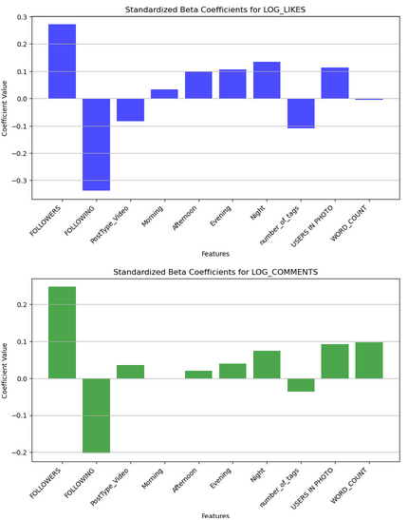
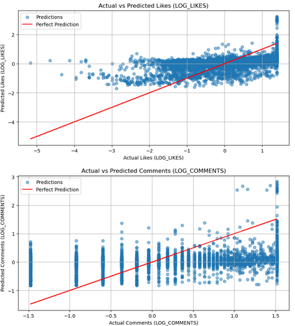
Key Predictors of Likes and Comments
What Drives Engagement ?
The number of followers and following were the most significant predictors of likes and comments.
Other important factors included the timing of the post, the type of post (photo or video), and the number of users tagged in the post.
Notes:
From my analysis, the number of followers and following emerged as the strongest predictors of likes and comments. Timing and post type, particularly photos over videos, also played significant roles. Additionally, tagging users and the number of hashtags impacted engagement, but their effects varied between micro and macro influencers.

Slide 6
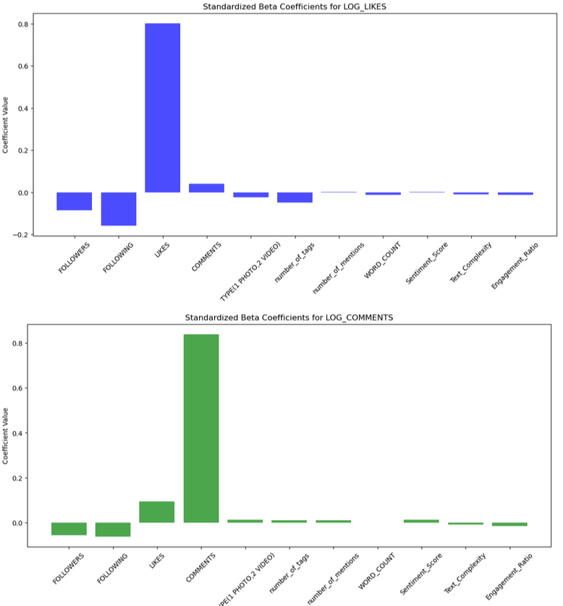

The Impact of New Variables
Digging Deeper
Adding new variables, such as sentiment score, text complexity, and engagement ratio, improved the predictive power of the models.
Posts with positive sentiment and simpler text tend to receive more likes and comments.
Notes:
By introducing new variables like sentiment score, text complexity, and engagement ratio, the predictive power of the models improved. For example, posts with positive sentiment and simpler captions were found to attract more likes and comments

Slide 7
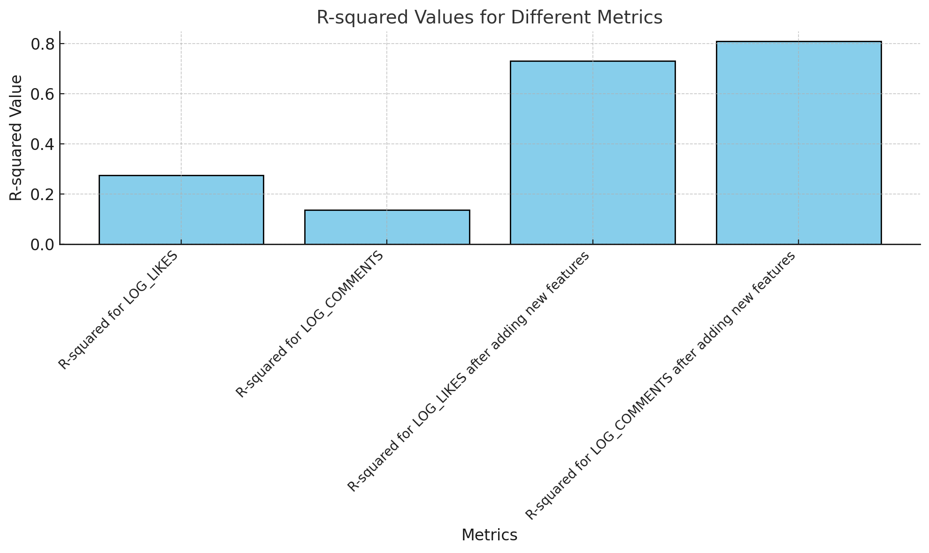
As per the graphs we can emphasize that the R-squared values have significantly increased after adding new features for predicting Likes and Comments.

Slide 8
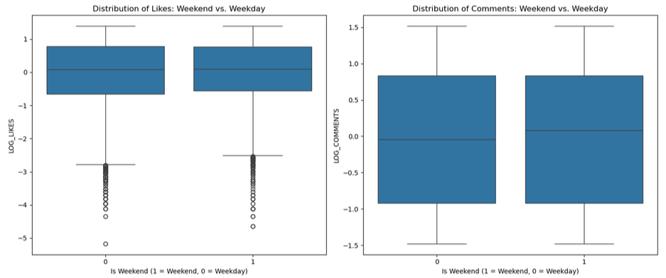
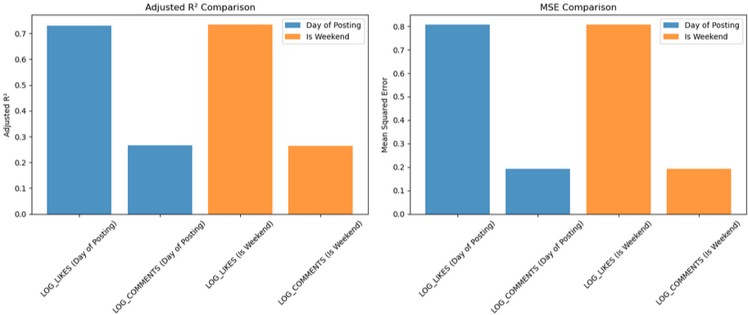
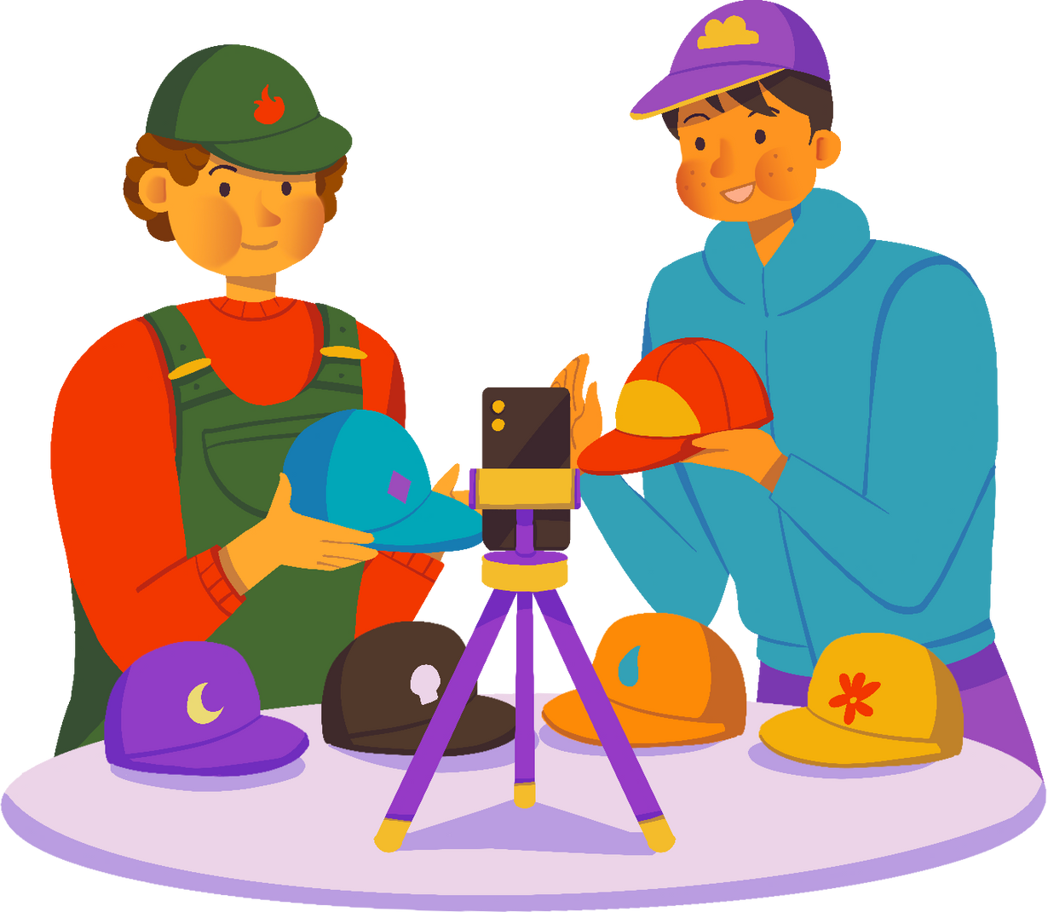
Weekend vs. Weekday Posts
The Weekend Effect
Weekend posts generally receive more likes and comments than weekday posts.
This effect is particularly pronounced for comments.
Notes:
A key finding is the 'weekend effect,' where posts made on weekends tend to receive more likes and comments than weekday posts. This effect was particularly noticeable for comments, indicating that influencers should strategically time their posts to maximize engagement.

Slide 9
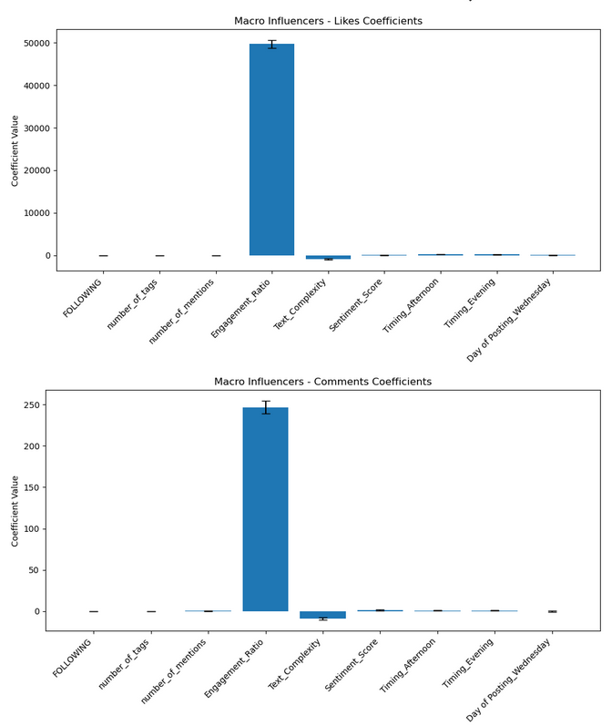
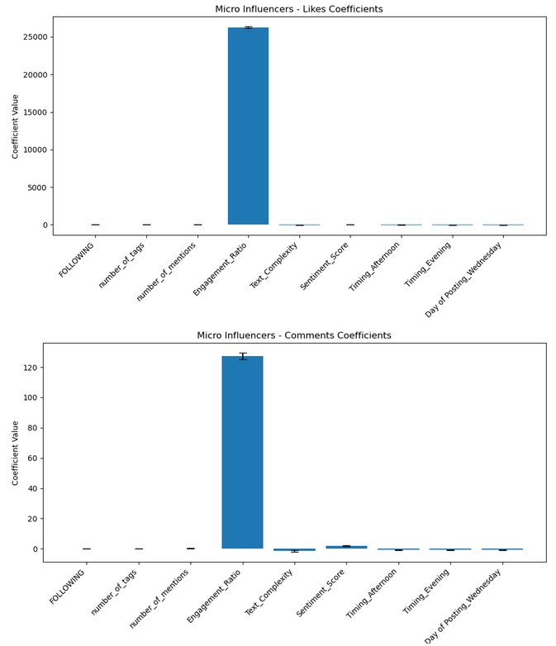

Micro vs. Macro Influencers
Tailoring Your Strategy
The factors that drive engagement can differ between micro (less than 50,000 followers) and macro (more than 50,000 followers) influencers.
For example, the timing of the post can have a different impact on engagement depending on the influencer's size.
Notes:
Micro and macro influencers differ in what drives engagement. For micro-influencers, audience interaction plays a greater role, making personalized strategies crucial. For macro-influencers, content type and timing, such as posting in the afternoon, significantly influence engagement

Slide 10
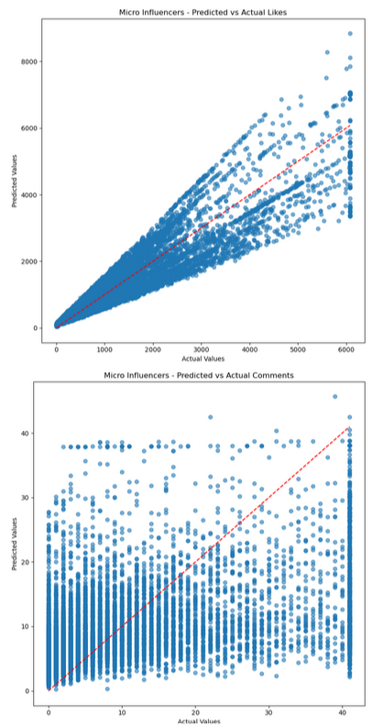
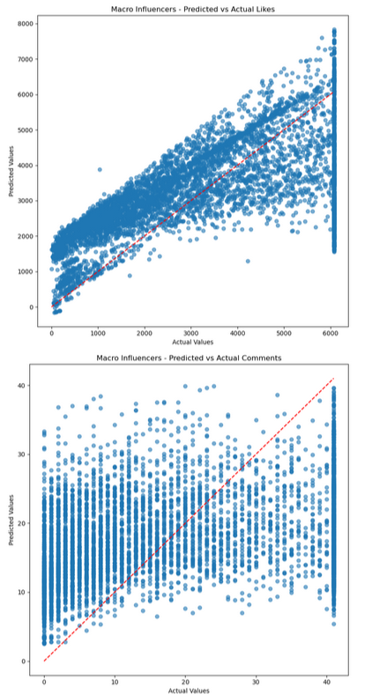
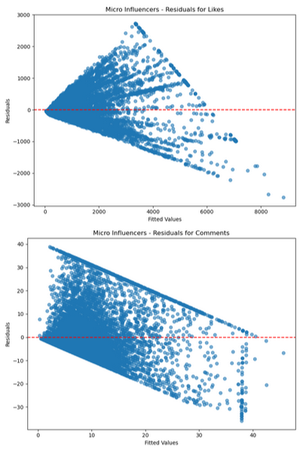
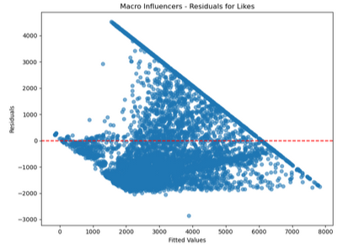
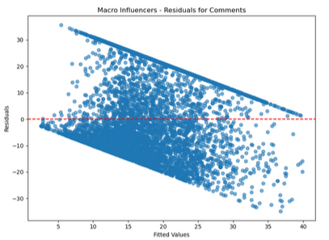
Predicted Value vs Actual Value
Model Performance
Adjusted R-squared Values for Likes and Comments:
Micro Influencers:
Likes: 0.800
Comments: 0.068
Macro Influencers:
Likes: 0.339
Comments: 0.031
Key Observations:
Engagement Ratio consistently emerged as the strongest predictor for Likes.
Timing of posts (Evening for Micro, Afternoon for Macro) influenced Comments.
Notes:
The models performed well, with adjusted R-squared values of 0.8 for likes and 0.068 for comments for micro-influencers, and 0.339 and 0.031 for macro-influencers, respectively. The engagement ratio consistently emerged as the strongest predictor for likes, highlighting its importance across influencer categories.

Slide 11

Macro Influencers:
Maintain high Engagement Ratios and post in the Afternoon for increased engagement.
Simplify captions for broader appeal.
Macro Influencers:
Maintain high Engagement Ratios and post in the Afternoon for increased engagement.
Simplify captions for broader appeal.
Macro Influencers:
Maintain high Engagement Ratios and post in the Afternoon for increased engagement.
Simplify captions for broader appeal.
Conclusions and Recommendations
Key Takeaways for Social Media Influencers
Focus on building a large and engaged follower base.
Optimize the timing of your posts based on your audience.
Craft high-quality content with positive sentiment and simple language.
Use a variety of content formats, including photos and videos.
Don't forget the weekend effect!
Micro Influencers:
Focus on maximizing Engagement Ratio and posting during Evenings.
Incorporate positive sentiments in captions.
Macro Influencers:
Maintain high Engagement Ratios and post in the Afternoon for increased engagement
Simplify captions for broader appeal
Notes:
Based on these findings, influencers should:Focus on building an engaged follower base.
Optimize post timing—micro-influencers should post in the evening, while macro-influencers should post in the afternoon.
Use captions with positive sentiment and simple language for broader appeal.
Don’t underestimate the power of photos and the weekend effect!

Slide 12

Lesson Learnt
How to critically analyze data, innovate and derive actionable insights using statistical modeling in social media analytics to make business decisions ."
Notes:
This project taught me how to critically analyze data, innovate, and derive actionable insights using statistical modeling. These skills are invaluable for solving real-world problems in social media analytics and marketing."

Slide 13
Thank You
Certain timing strategies (e.g., morning or evening posts) positively influenced engagement.
Post content, such as the number of hashtags and users tagged, showed a varying influence on likes and comments depending on the influencer type (micro or macro).
Innovative variables, such as Text Complexity Score and Sentiment Score, provided unique insights.
Micro and macro influencers exhibited differences in what drives engagement:
Micro Influencers: Engagement depended more on follower interactions and personalized strategies.
Macro Influencers: Content type and timing played a larger role in engagement.
+123-456-7890
arafat50610@gmail.com
123 Anywhere St., Any City
Notes:
Thank you for your time and attention. I’m happy to answer any questions you may have. You can also reach out to me via the contact information on this slide.

Slide 14





















01
Best Time to Post
Hashtags
06
Posts in the evening (for micro-influencers) and afternoon (for macro-influencers) see higher engagement.
Using an optimal number of hashtags increases visibility and engagement.
02
Day of the Week
Maximizing Instagram Engagement: Key Insights
Tagged Users
07
Posts made on weekends outperform weekday posts, particularly for comments.
Posts with tagged users show reduced engagement, indicating a preference for organic content.
03
Optimal Post Type
Caption Sentiment
08
Photos generate more likes and comments compared to videos.
Positive sentiment in captions correlates with increased likes, while simpler text garners more comments.
04
Engagement Ratio
Text Complexity
09
A higher engagement ratio (followers-to-following) strongly predicts more likes and comments.
Posts with less complex captions attract more comments, making simplicity key to engagement.
05
Audience Size
Timing Strategies
10
Micro-influencers benefit more from engagement strategies than macro-influencers.
Tailored timing strategies based on the influencer’s audience type (micro vs. macro) enhance engagement metrics.

